Slide 1
Career Exploration Announcement Before TA Lesson:
Eat with an expert once a month in Lecture Hall September 14: Careers in the Military (Air Force & Army)
September 14th-Thursday
1st Period-Careers in the Military (Air Force & Army)
October 12th-Thursday
2nd Period-Careers in the Performing Arts
November 9th-Thursday
3rd Period-Careers in Fire Science & Rescue
December 14th-Thursday
5th Period-Careers in Engineering
Must sign up on link (might not be live yet): Eat With An Expert

Slide 2
TA COLLEGE AND CAREER PLANNING
NAVIANCE

Slide 3
Naviance Login Directions
Go to ClassLink: http://launchpad.classlink.com/elkhorn
Click on the following Icon and you should automatically be logged in to Naviance:

Slide 4
WHAT CAREER OPTIONS ARE YOU CONSIDERING?
Across the top of the Naviance Home Screen:
Click on Careers, Explore Careers

Slide 5
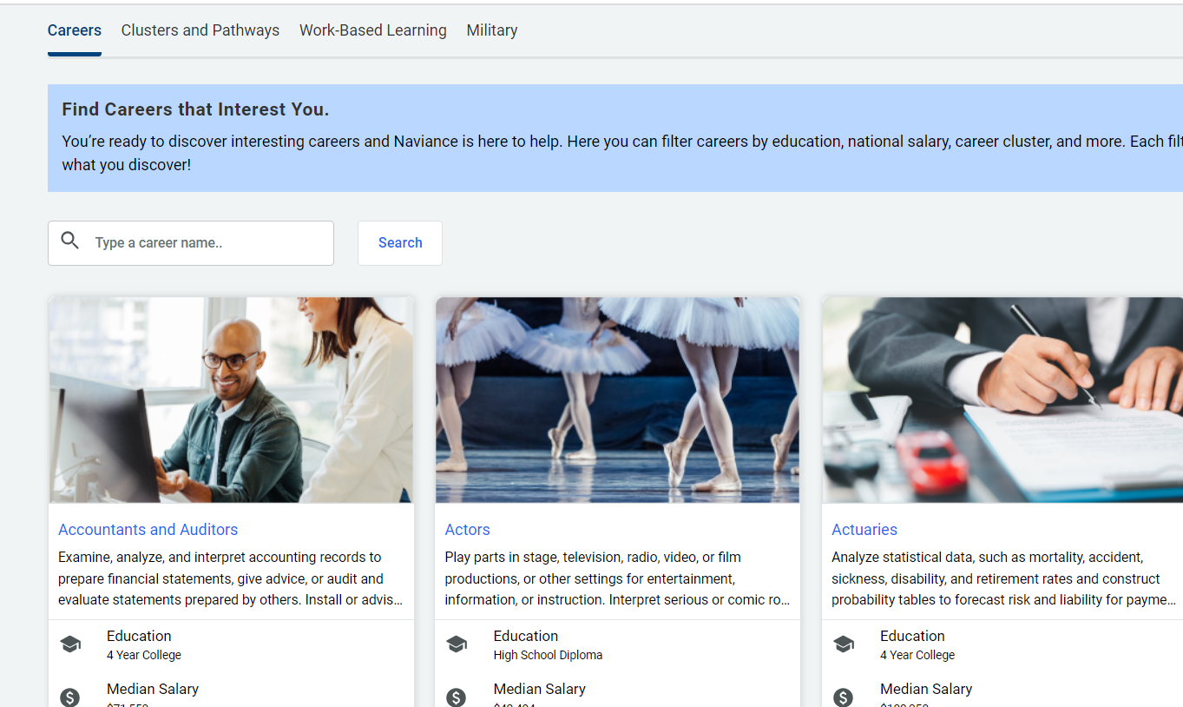
Type in career titles of interest

Slide 6
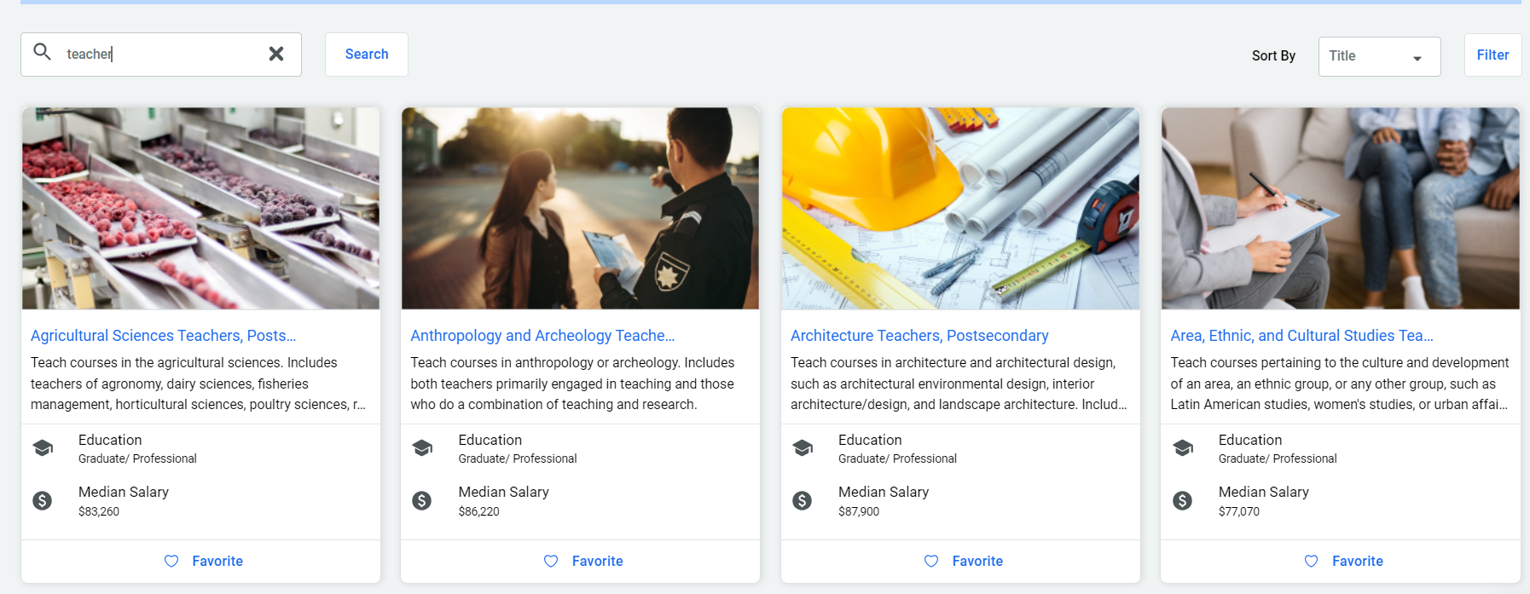
From the list that appears, favorite your top choices to receive information about upcoming events regarding that career.

Slide 7
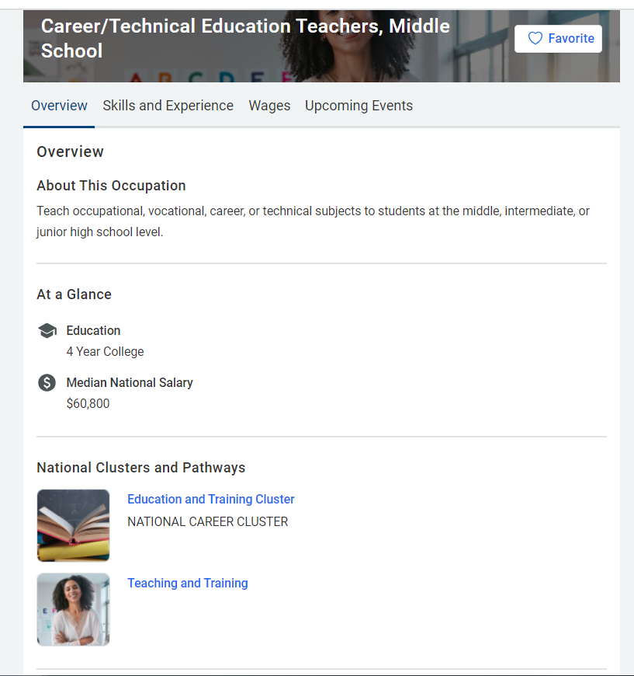
Click to READ ABOUT THE CAREER OF YOUR CHOICE (scroll down)-- AND CLICK ON EACH TAB

