Slide 1
Career Exploration Announcement Before TA Lesson:
Eat with an expert once a month in Lecture Hall September 14: Careers in the Military (Air Force & Army)
September 14th-Thursday
1st Period-Careers in the Military (Air Force & Army)
October 12th-Thursday
2nd Period-Careers in the Performing Arts
November 9th-Thursday
3rd Period-Careers in Fire Science & Rescue
December 14th-Thursday
5th Period-Careers in Engineering
Must sign up on link (might not be live yet): Eat With An Expert

Slide 2
NAVIANCE
College planning resources for seniors

Slide 3
Naviance Login Directions
Go to ClassLink: http://launchpad.classlink.com/elkhorn
Click on the following Icon and you should automatically be logged in to Naviance:
‹#›

Slide 4
Click on Colleges--Colleges I’m Thinking About

Slide 5
Seniors should review, update or add to their list of colleges.
Add Colleges you are applying to.
Remove Colleges that are no longer on your list.

Slide 6
Seniors need to request transcripts to be sent to colleges through Naviance
Click on Colleges, Colleges I am applying to. Add colleges you are applying to.
Click on request transcript (right side of page) to add electronic transcript request.

Slide 7
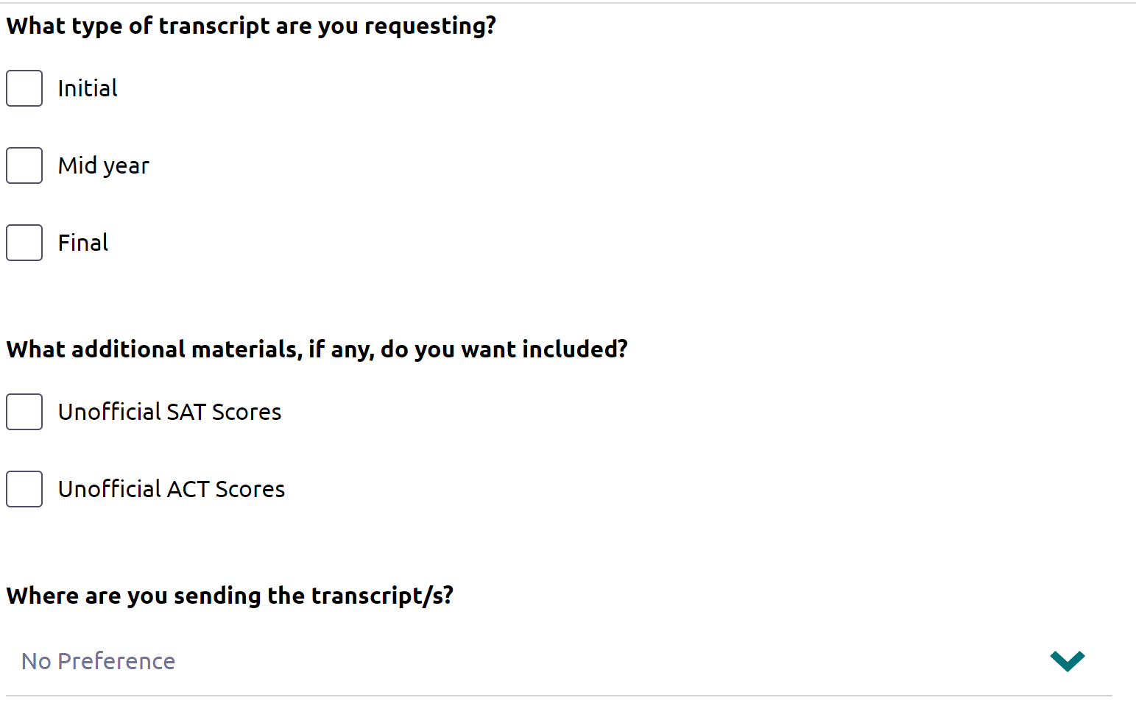
Select Initial
We can’t send ACT Scores. You have to request directly from ACT.
Type in Name of College--Click on request and finish.

Slide 8
Take advantage of meeting with college reps..
Click on College--Research Colleges--College Visits

Slide 9
Seniors should begin exploring scholarship opportunities.
Click on Colleges, Scholarship Search

Slide 10
Save the Date
Junior/Senior Parent Planning Night
Where: EHS Auditorium
When: Sept. 11 at 6:00 pm

