Slide 1
TA
COLLEGE AND CAREER PLANNING
Eat with an expert once a month in Lecture Hall October 12 Careers in the Performing Arts
October 12th-Thursday
2nd Period-Careers in the Performing Arts
November 9th-Thursday
3rd Period-Careers in Fire Science & Rescue
December 14th-Thursday
5th Period-Careers in Engineering
Must sign up on link: Eat With An Expert

Slide 2
TA COLLEGE AND CAREER PLANNING
NAVIANCE
ROADTRIP NATION

Slide 3
Naviance Login Directions
Go to ClassLink:
Click on the following Icon and you should automatically be logged in to Naviance:

Slide 4
ROADTRIP NATION
Archive of video interviews with more than 300 local, national, and international leaders.
All interviews are conducted for students by students.
Roadtrip Nation's video interviews are designed to help students choose career paths after listening to stories from leaders across hundreds of industries.

Slide 5
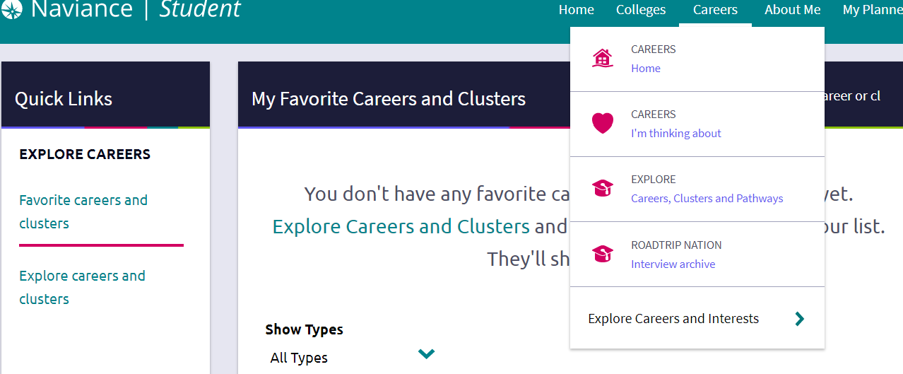
WHAT HAVEN’T YOU THOUGHT OF?
Upper right hand corner of Naviance:
Click on Careers--Roadtrip Nation Interview Archive

Slide 6
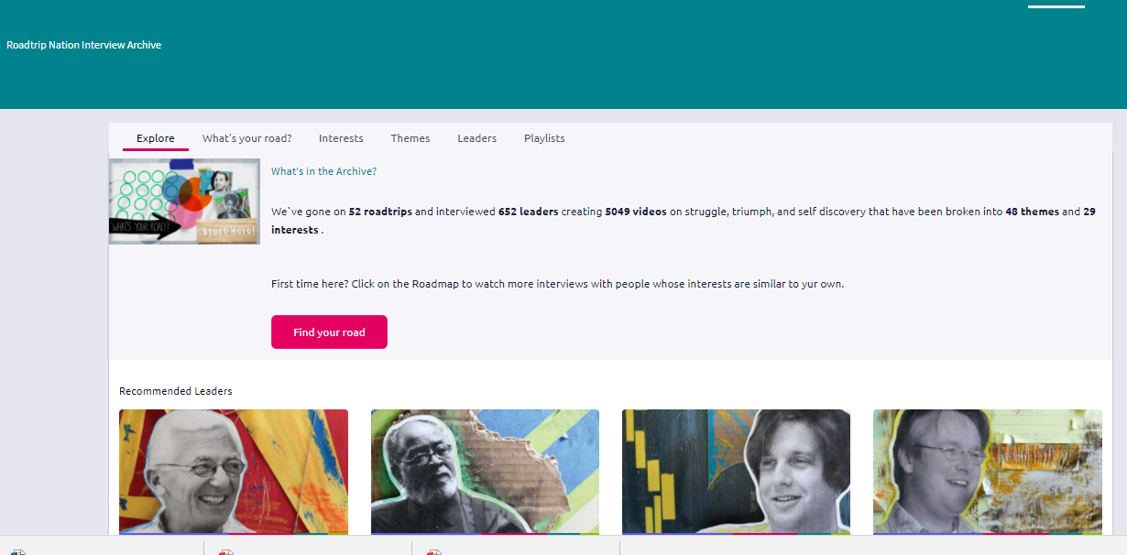
ROADTRIP NATION INTERVIEW ARCHIVE
EXPLORE BY
INTEREST
THEMES
LEADERS
PLAYLISTS

Slide 7
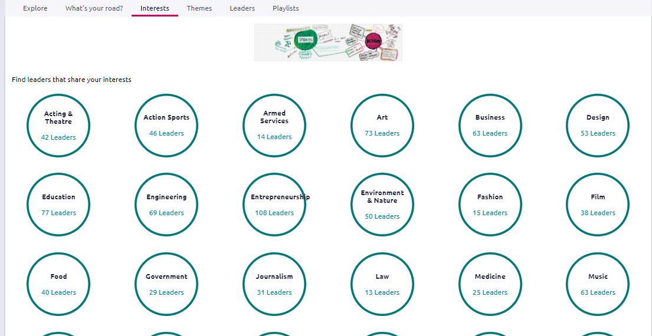
CLICK ON INTERESTS
FIND TWO DIFFERENT AREAS OF INTEREST
WATCH A VIDEO UNDER EACH AREA
IF YOU FIND NEW CAREER OF INTEREST, ADD TO CAREER FAVORITES (SEE NEXT SLIDE FOR DIRECTIONS ON HOW TO DO THAT)

Slide 8
Look up new career idea in career search box
Click on Favorite under the name of your career choice.

Slide 9
READ ABOUT THE NEW CAREER OF YOUR CHOICE-- CLICK ON EACH TAB TO LEARN MORE

Slide 10
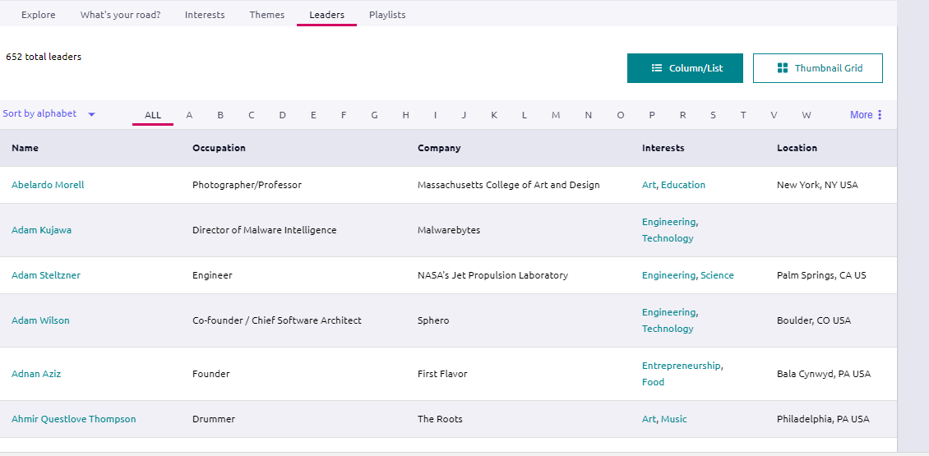
CLICK ON LEADERS
FIND TWO VIDEOS OF INTEREST
IF YOU FIND A NEW CAREER INTEREST AREA, ADD TO CAREER FAVORITES

Slide 11
YOU WILL CONTINUE TO HAVE OPPORTUNITIES TO EXPLORE YOUR COLLEGE AND CAREER OPTIONS IN TA, FEEL FREE TO NAVIGATE THROUGH ROADTRIP NATION ON YOUR OWN

